Slide 1

Machine and Deep Learning Classification for Sentiment Analysis On Food Reviews
Presented By: Kushagra Gupta
Supervised By: Dr. Thomas Roelleke

Slide 2

Why NLP?
Understanding human linguistic has become most popular task as:
Content sharing is at the peak.
Each person on this earth generates about 1.7 MB of data every second.
Social media platforms are soaring.
People are moving their business online in industries like travel, food, aviation, etc.
Reviewing a product/service is now becoming habitual to people.
Major establishments Twitter, Facebook, Uber etc. are exploiting their customer voices to understand the hidden sentiment and flourish by providing better services to their users.
Food companies like Amazon, Uber eats, Deliveroo, Just Eat, Zomato etc. are now fulfilling customer needs online using sentiment analysis.

Slide 3
Choosing the best vectorization technique for model optimization.
Choosing the right statistical model(N-gram Model).
Comparison between linear vs Non-linear Classifiers.
Exploiting deep learning technique(CNN).
Performing Sentiment analysis on food reviews using textual data
Research Aims

Slide 4
Model Design
Model has been designed to perform sentiment classification for Amazon fine food reviews dataset.
The Model performs multi-class classification on text data present in reviews field with score field as label.
Comparison has been done between different techniques and models using both machine and deep learning techniques.
Multiple phases has been used in the model for optimizing model performance.
Tokenization and Word Embedding
Deep Learning
CNN
Data Loading
Data Cleaning
Pre-processing and
Feature Extraction
Vectorization
and Statistical Modelling
Machine Learning
Random Forests
Logistic
Decision Trees

Slide 5


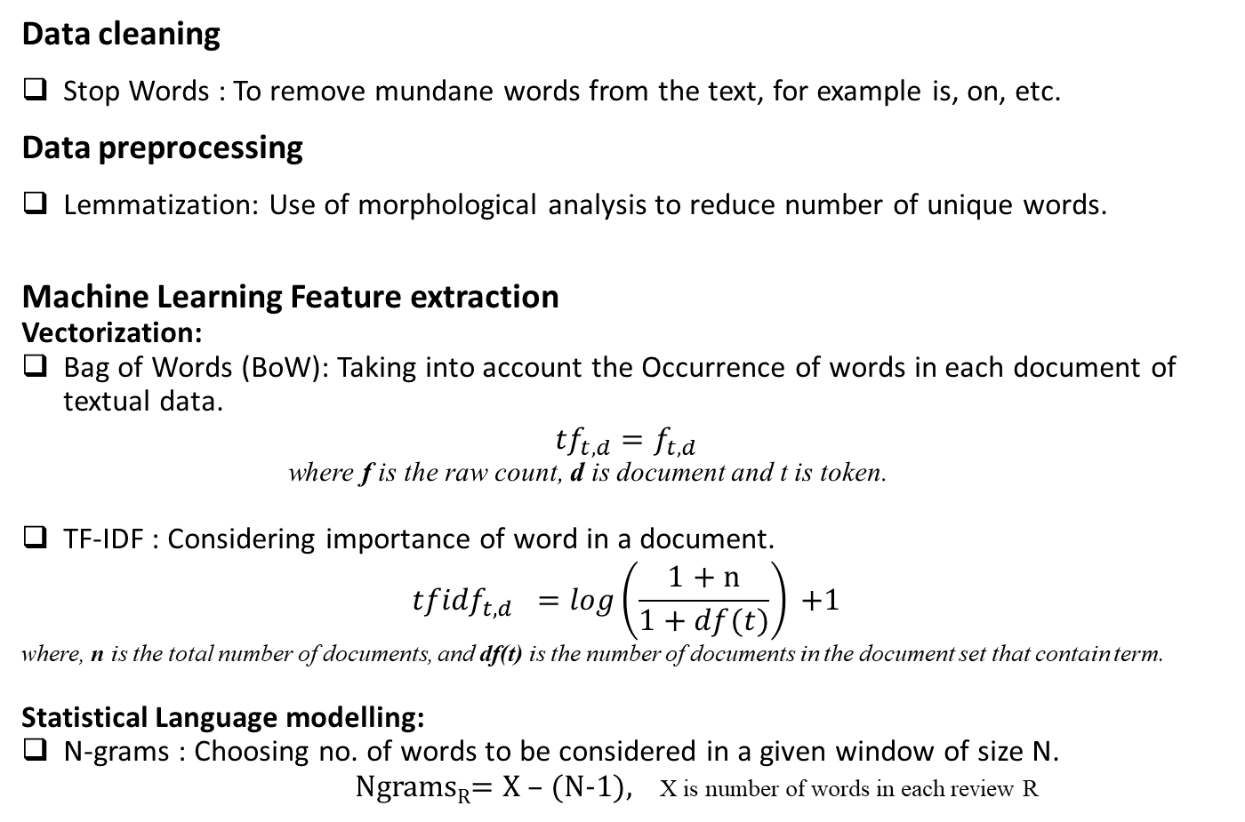
Model Design(contd.)
Data cleaning
Stop Words : To remove mundane words from the text, for example is, on, etc.
Data preprocessing
Lemmatization: Use of morphological analysis to reduce number of unique words.
Machine Learning Feature extraction
Vectorization:
Bag of Words (BoW): Taking into account the Occurrence of words in each document of textual data.
$${tf_{t,d}=f}_{t,d}$$
where f is the raw count, d is document and t is token.
TF-IDF : Considering importance of word in a document.
$${tfidf}_{t,d} =log\left(\frac{1+n}{1+df(t)}\right){+1}$$
where, n is the total number of documents, and df(t) is the number of documents in the document set that contain term.
Statistical Language modelling:
N-grams : Choosing no. of words to be considered in a given window of size N.
Ngrams_{R}= X – (N-1), X is number of words in each review R

Slide 6

Model Design(contd.)
Deep Learning Feature extraction
Vectorization:
Tokenization : Converting each word into token to form the vocabulary of indexes.
Word Embedding: Providing each word token with the vector representation to capture the semantic similarity between the words.
Machine Learning Models
Both Linear and Non-linear models have been considered.
Logistic Regression : Regression with L2 regularization.
Decision Trees Classifier : Classifier using CART algorithm.
Random Forest Classifier
Deep Learning Models
Deep Learning CNN model has been created using 1D convolution layer to read textual data.
One-word Considered: Creating window to consider one word as input.
Two-word Considered : Creating window to take into account two words at a time.

Slide 7
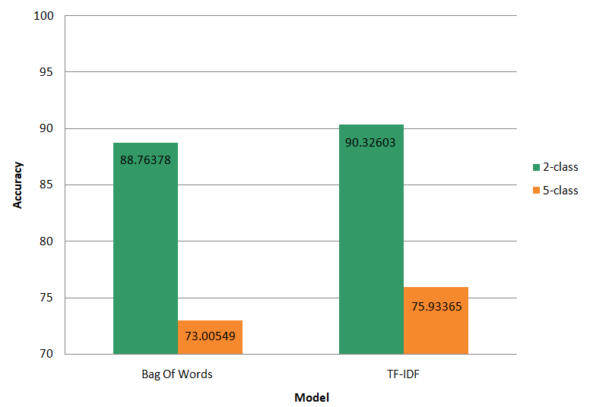
Results
Vectorization Comparison
Bag of words and TF-IDF techniques are compared for multi-class label using Logistic regression model.
TF-IDF performs better than the BoW.
2-class sentiment is easier to classify than 5-class sentiment.
Vectorization Comparison

Slide 8
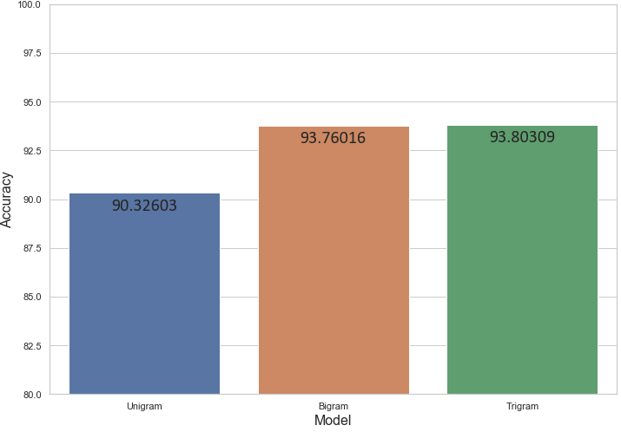
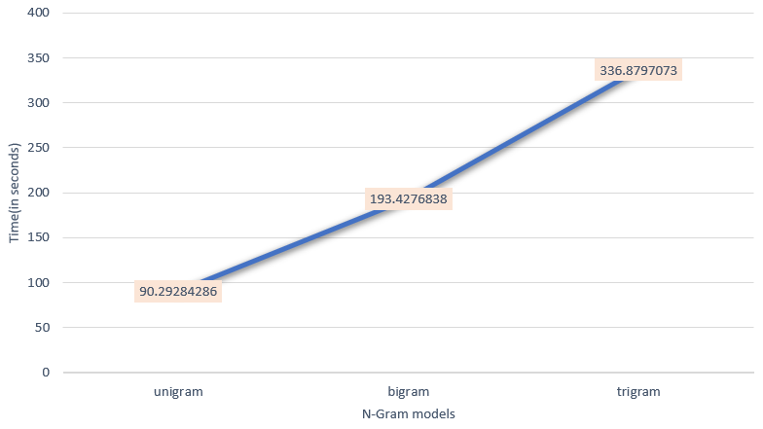
Results (contd.)
N-gram Model Comparison
Statistical language modelling has been implemented with logistic regression for choosing the best N-gram model.
Bigram model works well both in accuracy and computation time.
The N-gram model accuracy increase faintly with increasing no. of N, but at the cost of computation time.
N-gram Model Comparison
Computation cost for N-gram Models

Slide 9
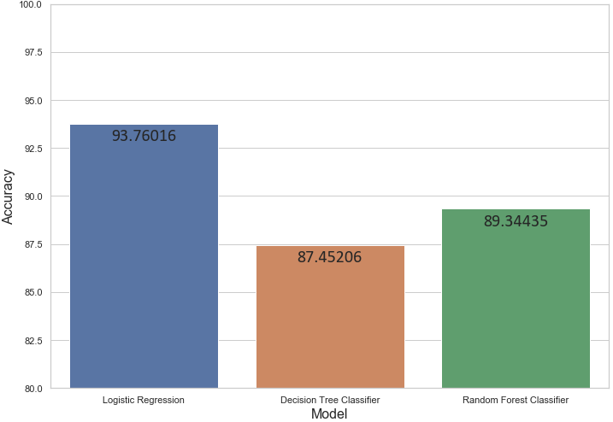
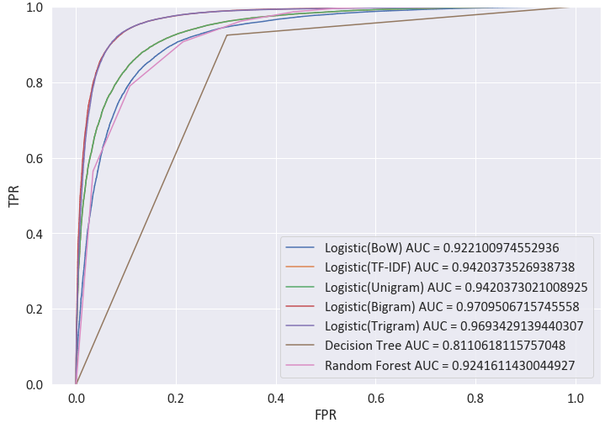
Results (contd.)
Linear vs Non-Linear Comparison
The Linear and non-linear models have been compared in the analysis.
Logistic Regression perform well in the classification task beating other state-of-arts methods for food review classification.
Non-linear classifiers performs inadequately as compared to linear classifier
Linear vs Non-Linear Model Comparison
ROC Comparison for models

Slide 10
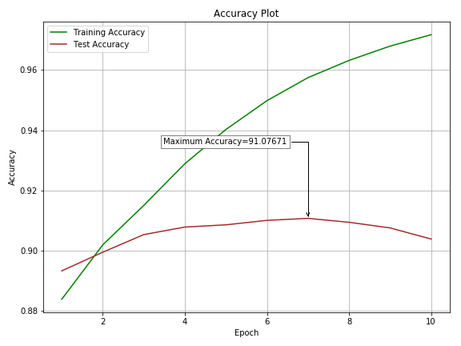
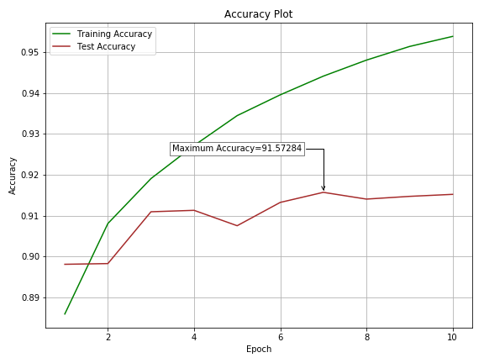
Results (contd.)
CNN model Comparison
Two CNN models have been used in the study to act like N-gram model, the first is when considering one word window and other when considering two words window.
Two words window model performs better than 1-word window model.
Computation cost is around 2 times more than the other machine learning model considered in the study.
One-word Window
Two-word Window

Slide 11
Results (contd.)
Model comparison has been done for all the models used in the study.
Linear Logistic model(Bigram) has performed exceptionally well.
CNN model have performed as well as linear model but at the cost of high computation time.

Slide 12

Future Work
Use of upcoming deep learning vectorization techniques like word2vec,genism,fasttext.
Classifying the data into multi-label classes for larger datasets.
Use of deeper deep learning models, adding more layers to the CNN.
Taking use of more advanced continuous deep learning models like RNN, TCN etc.

Slide 13
Thank You

Slide 14
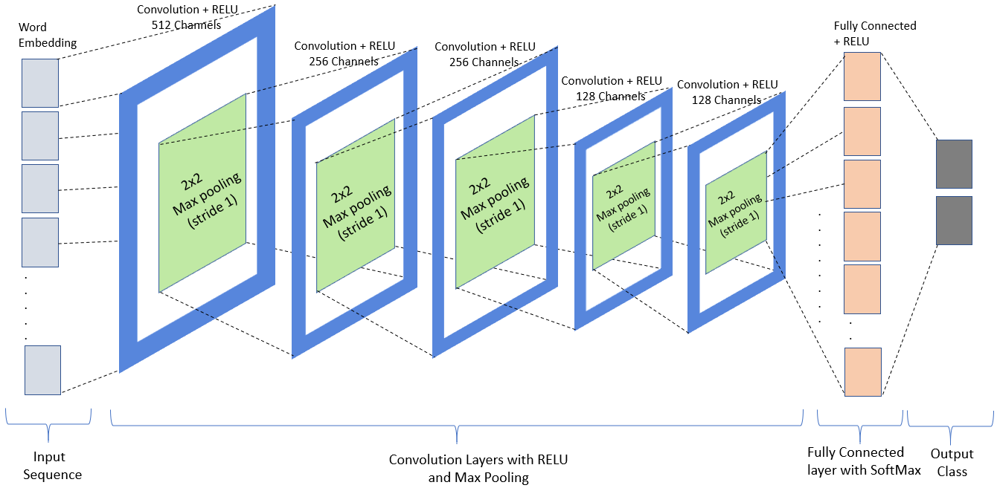
Aid Slide
CNN Architecture

